Slide 1

Chapter 11 Quantitative Genetics
Presenter: Florence Fields

Slide 2
Polygenic.
Developed primarily by R.A. Fisher 1918 and Sewall Wright 1921 – to resolve the controversy of whether discrete Mendelian factors (genes) could explain the genetic basis of continuously varying characters
To improve domesticated animals and agricultural crops
Understand genetic variation in natural populations

Slide 3
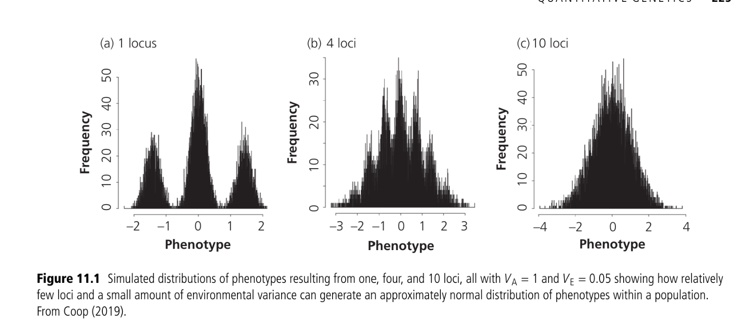

11.1 Heritability
$$Vp=VE+VG$$
$$Vp=VE+VG$$
$$Vp=VE+VG+VD+VI$$

Slide 4

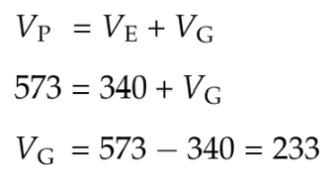


11.1.1 Broad-sense Heritability (H_{B})
SEWALL Wright removed virtually all of the genetic differences between Guinea pigs within lines by continued sister brother matings for many generations. The total phenotypic variance ($Vp$) in the population as a whole (consisting of many separate inbred lines) for the amount of white spotting was 573. The average variance within the inbred lines was 340; this must be equal to $VE$ because genetic differences among individuals within the lines were removed through inbreeding.
The portion of phenotypic variability that results from genetic difference among individuals
_{Using the example of the right}

Slide 5

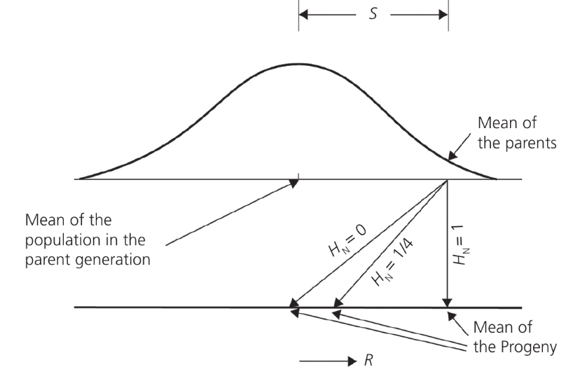
11.1.2 NARROW- SENSE HERITABILITY (H_{n})
H_{N} is the proportion of total phenotypic variation that is due only to additive genetic variation (V_{A})among individuals

Slide 6
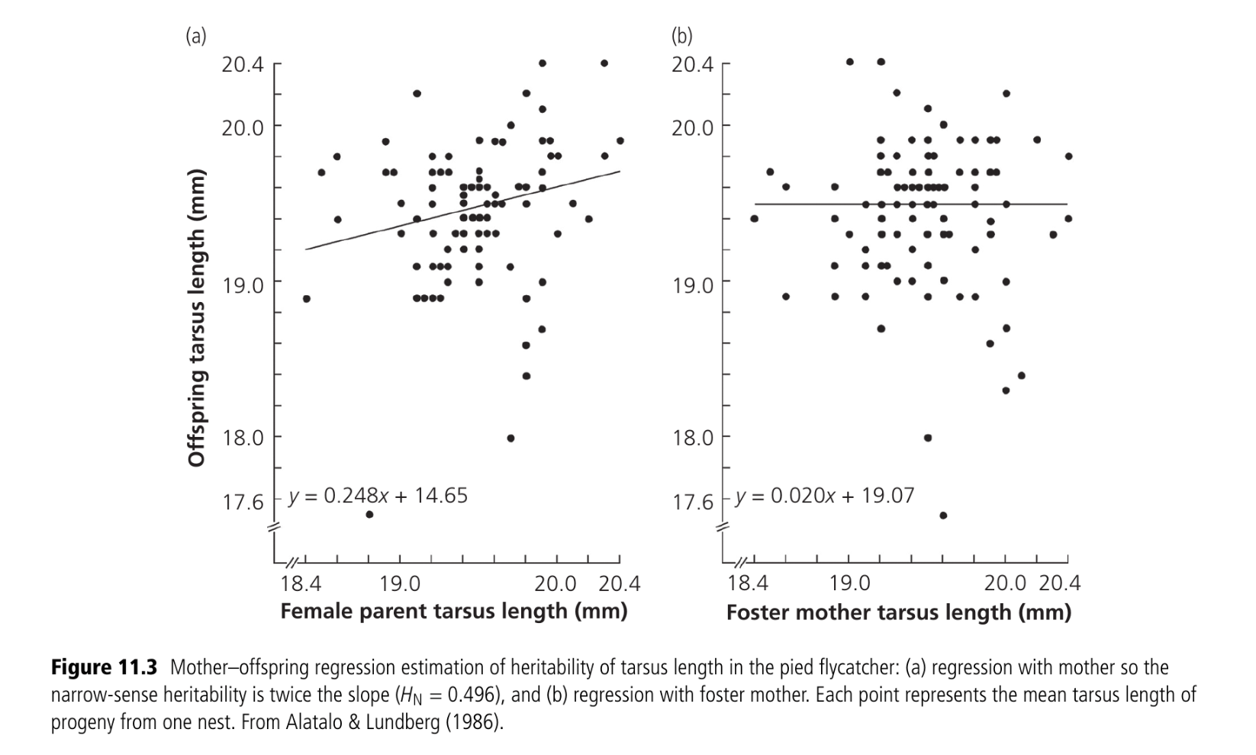

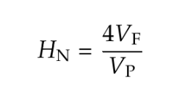
11.1.3 ESTIMATING HERITABILITY
Parent Offspring Regression
Progeny Testing
Solving for H_{N}
Animal Model

Slide 7

Genotype-by-environment (GxE) interactions
11.1.4 Genotype by environment interactions

Slide 8
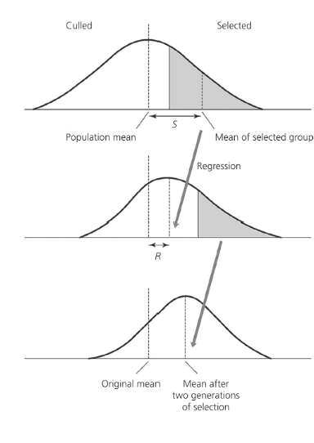



11.2 SELECTION ON QUANTITATIVE TRAITS
No response to directional selection then
If the mean of the selected progeny equals the mean of the selected parents then

Slide 9

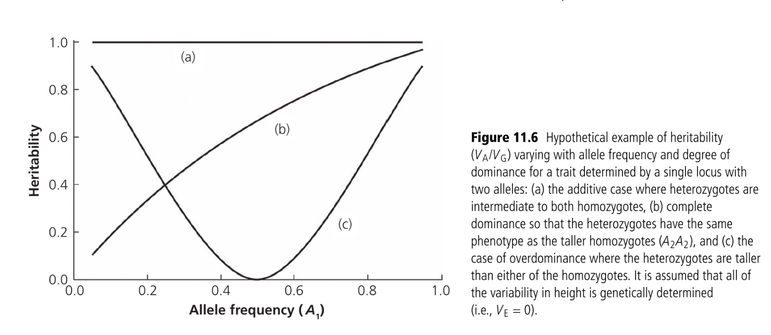
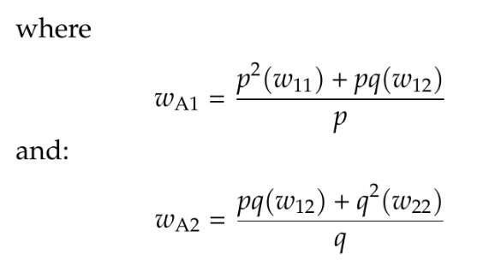

11.2.1 HERITABILITIES AND AELLE FREQUENCIES

Slide 10
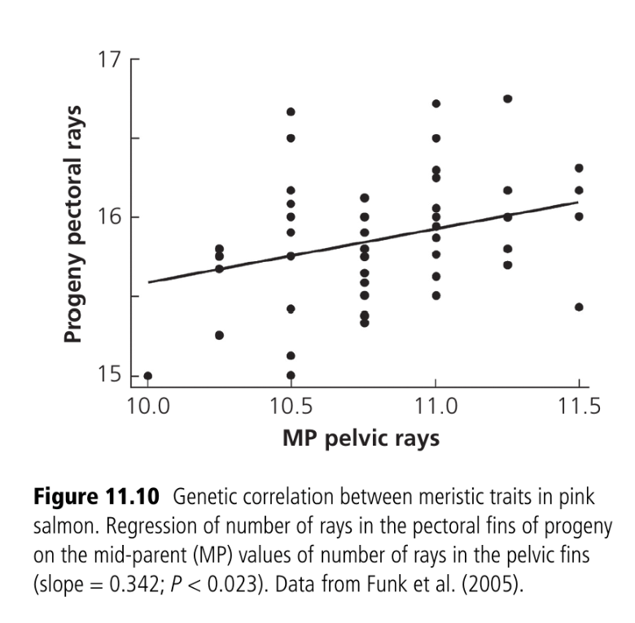
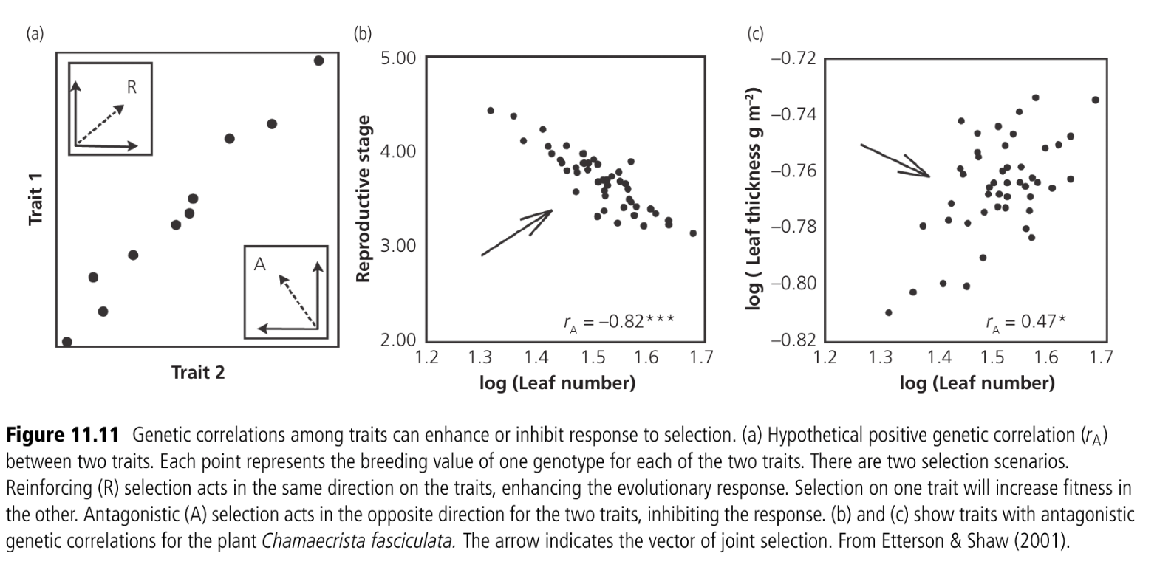
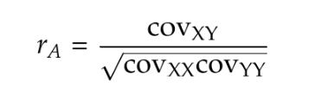
11.2.2 Genetic Correlations

Slide 11
11.3 FINDING GENES UNDERLYING QUANTITATIVE TRAITS
Fog of Quantitative Variation
High-throughput sequencing
QTL Mapping
Candidate Gene Approaches
Genome-Wide Association mapping

Slide 12

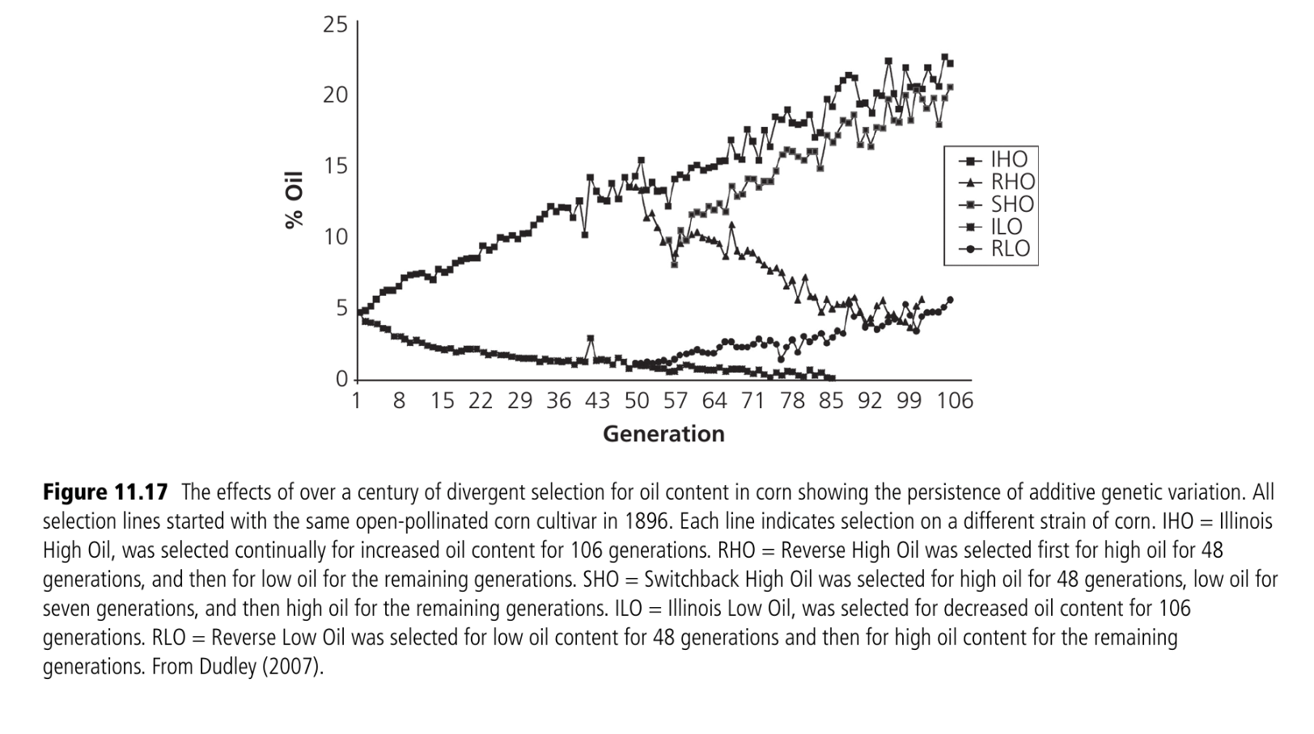
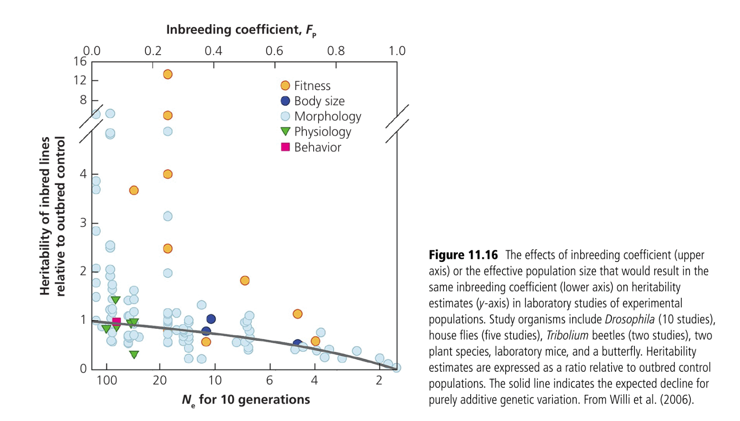
11.4 LOSS OF QUANTITATIVE GENTIC VARIATION
11.4.1 EFFECTS OF GENETIC DRIFT AND BOTTLENECKS
11.4.2 EFFECTS OF SELECTION

Slide 13
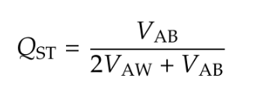
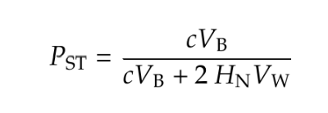
11.5 Divergence among populations

Slide 14
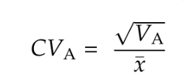

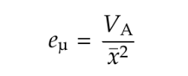
11.6 QUANTITATIVE GENETICS AND CONSERVATION
Evolvability
Fisher’s fundamental theorem of natural selection

Slide 15
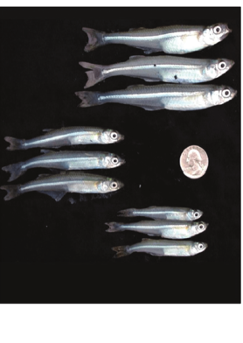
11.6.1 RESPONSE TO SELECTION IN THE WILD
11.6.2 CAN MOLECULAR GENETIC VARIATION WITHIN POPULATIONS ESTIMATE QUANTITATIVE VARITATION?
Molecular genetic variation within a population should be used with caution to make predictions about quantitative genetic variation.
E.g. pink salmon caught off the coast of North America where it had declined between 1950 and 1974 because of size selective harvesting. They did a size selective experiment and found the changes within the genome can result from a size selective fishery.

Slide 16
11.6.3 Does population divergence for molecular markers estimate divergence for quantitative traits?
In the absence of quantitative genetic information, the amount of molecular genetic variation between populations should be used carefully to make predictions about quantitative genetic variation

